Slide 1
The Quadratic Formula
EQ: How can I solve quadratic equations using the quadratic formula?
All – Identify a, b and c and substitute them into the quadratic formula where the equation is of the form x² + bx+ c = 0.
Most – Solve quadratic equations of the form ax² + bx - c = 0 using the quadratic formula.
Some – Solve quadratic equations using the quadratic formula involving positives and negatives .
Stretch – To rearrange quadratic equations to get to the form ax² + bx + c = 0 and to solve a word problem using the quadratic formula.

Slide 2
A quadratic equation is of the form
ax² + bx + c = 0
Example –
2x² + 6x + 4 = 0
a = 2
b = 6
c = 4
Notes:
Use questioning to answer the above example

Slide 3
On your whiteboards write down a, b and c for the following quadratic equations
4x² + 7x + 6 = 0
a = 4
b = 7
c = 6

Slide 4
On your whiteboards write down a, b and c for the following quadratic equations
x² + 8x + 43 = 0
a = 1
b = 8
c = 43

Slide 5
On your whiteboards write down a, b and c for the following quadratic equations
5x² - 6x + 43 = 0
a = 5
b = -6
c = 43

Slide 6

The quadratic formula
$$x=\frac{−b± \sqrt{b^{2}−4ac}}{2a}$$
It is used to find the value of x of a quadratic equation of the form
ax² + bx + c = 0

Slide 7
Use the quadratic formula to solve x² + 7x + 8 = 0
1x² + 7x + 8 = 0
a = 1 b = 7 c = 8
This is the quadratic formula
–b ± √b² – 4ac
x =
2a
SUBSTITUTE
-7 ± √(7)² – (4 × 1 × 8)
x =
SIMPLIFY
2 × 1
You need to do this twice, once adding and once taking away
-7 ± √49 – 32
SPLIT
x =
2
SOLVE USING YOUR CALCULATOR
-7 + √17
-7 – √17
x =
or
x =
2
2
x = -1.438
x = -5.562 (to 3 d.p.)

Slide 8
Your turn
Use the quadratic formula to solve
x² + 5x + 3 = 0
1x² + 5x + 3= 0
a = 1 b = 5 c = 3
This is the quadratic formula
–b ± √b² – 4ac
x =
2a
SUBSTITUTE
-5 ± √(5)² – (4 × 1 × 3)
x =
You need to do this twice, once adding and once taking away
SIMPLIFY
2 × 1
-5 ± √25 – 12
SPLIT
x =
2
SOLVE USING YOUR CALCULATOR
-5 + √13
-5 – √13
x =
or
x =
2
2
x = -0.697
x = -4.303 (to 3 d.p.)

Slide 9
Use the quadratic formula to solve 3x² – 8x – 7 = 0
3x² - 8x - 7 = 0
a = 3 b = -8 c = -7
This is the quadratic formula
–b ± √b² – 4ac
x =
SUBSTITUTE
2a
-(-8) ± √(-8)² – (4 × 3 × -7)
x =
SIMPLIFY
2 × 3
You need to do this twice, once adding and once taking away
8 ± √64 – (-84)
SPLIT
x =
6
SOLVE USING YOUR CALCULATOR
8 + √148
8 – √148
x =
or
x =
6
6
x = 3.361
x = -0.694 (to 3 d.p.)

Slide 10
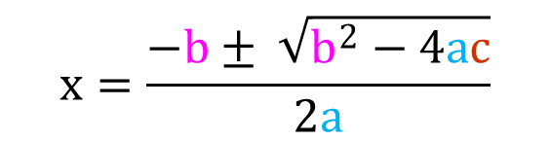
Solve these quadratic equations using the quadratic formula to 2 d.p
$$x=\frac{−b± \sqrt{b^{2}−4ac}}{2a}$$
x = - 1 or x = - 2
x = -2 or x = - 4
x = -1 or x = - 4
x = - 2 or x = - 9
x = - 0.26 or
x = - 7.74
f) x = 0.55 or
x = - 5.45
x = 0.32 or x = - 12.32
b) x = 0.48 or x = - 10.48
c) x = - 0.68 or
x = - 7.32
d) x = - 1 or
x = 0.29
e) x = 0.21 or
x = - 4.71
f) x = 0.48 or
x = - 2.08
x² - x - 10 = 0
3x² - 10x - 5 = 0
-4x² - 8x + 5 = 0
5x² - 3x - 2 = 0
-2x² + 9x - 2 = 0
10x² - 4 x - 1 = 0
x² + 3x + 2 = 0
x² + 6x + 8 = 0
x² + 5x + 4 = 0
x² + 11x + 18 = 0
x² + 8x + 2 = 0
x² + 6x + 3 = 0
x² + 12x - 4 = 0
x² + 10x - 5 = 0
x² + 8x + 5 = 0
7x² + 5x - 2 = 0
2x² + 9x - 2 = 0
5x² + 8x - 5 = 0
x = 3.70 or
x = -2.70
b) x = 3.77 or
x = -0.44
c) x = 0.5 or
x = - 2.5
d) x = 1 or
x = - 0.4
e) x = 4.27 or
x = 0.23
f) x = 0.57 or
x = - 0.17
2x² + 3x =12
2x² + 5x = 2
2x² = 3x + 12
If you reach this, please ask for a separate sheet
x = 1.81 or x = -3.31
x = 0.35 or x = -2.85
x = 3.31 or x = -1.81

Slide 11
Write at the top of your piece paper which colour questions you reached and feel confident with
All – Identify a, b and c and substitute them into the quadratic formula where the equation is of the form
x² + bx+ c = 0.
Most – Solve quadratic equations of the form ax² + bx - c = 0 using the quadratic formula.
Some – Solve quadratic equations using the quadratic formula involving positives and negatives .
Stretch – To solve a word problem using the quadratic formula.

Slide 12
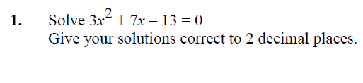

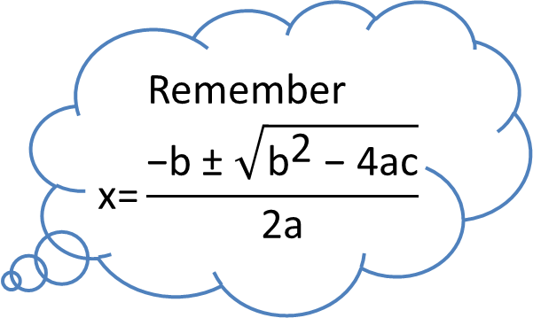
Answer this question on your white board
Remember
$$\text{x}\text{=}\frac{\text{−}\text{b} \text{±} \sqrt{{\text{b}}^{\text{2}} \text{−} \text{4}\text{ac}}}{\text{2}\text{a}}$$
Solution –
a = 3, b = 7, c = -13
$$\text{x} \text{=} \frac{\text{−}\text{7 }\text{±} \sqrt{{\text{7}}^{\text{2}}\text{−}\text{ (}\text{4} \text{x}\text{ 3 }\text{x}\text{ −13)}}}{\text{2} \text{x}\text{ 3}}$$
x = $\frac{\text{−7 ± }\sqrt{\text{49 }\text{− }\text{(−156)}}}{\text{6}}$
x = $\frac{\text{−7 }+\sqrt{\text{205}}}{\text{6}}$ or x = $\frac{\text{−7 }− \sqrt{\text{205}}}{\text{6}}$
x = 1.22 or x = -3.55

